Slide 1


Department of Computer Science & Engineering
Adarsh Institute of Technology & Research Centre, Vita
Class-TY
Mini Project Presentation on:
“Hostel Management System”
Team members :
Miss. Pawar Radhika Raju (CS3040) Miss. Todkar Sanika Vishnu (CS3041) Miss. Dinde Sanika Shashikant (CS3042)
Miss. Bandgar Aishwarya Sundar (CS3048)
Academic Year
2023-2024
Under Guidance of: Miss. S. L. Jadhav

Slide 2
Index
Introduction
Literature Survey
Existing System
Proposed System
Requirement Analysis
System Design
Screenshot
Future Scope
Conclusion
References

Slide 3

The hostel management system is the system that manages the details of the students staying in the hostel, admission details, staffs details and the fee paid by students details.
Hostel management gives on idea about how the students details, room allocation are maintained in the particular concern. The hostel management system also includes some special features. The modules of this project are student details, attendance details, room details, Payment details and student fee details.

Slide 4

Sr.n o | Title of Paper | Author | Year | Paper Gist
1. | Hostel Managemet System | Ritesh Kumar Bista UG Student, Department of Computer Science and Engineering HMR Institute of Technology and Management, Delhi, India. | IEEE 2021 | The management system makes the hostel allocation much easier for students. It automatically selects the student from waiting list and also keep track of hostel fees, out pass generation, complaint registration etc.

Slide 5
Sr. no | Title of Paper | Author | Year | Paper Gist
2. | Hostel Managemet System | Bikash Choudhary Bachelor of Computer Application, Department of Computer Science and Engineering, Galgotias University, Greater Noida, India. | IEEE 2022 | Author have created JAVA which focuses on reducing the paperwork. The framework replaces the manual hostel administration issues and also provides the data.

Slide 6
Sr. no | Title of Paper | Author | Year | Paper Gist
3. | Hostel Managemet System | Srikant Patnaik, Khushboo Kumari Singh 1Assistant Professor, 2,4,5Student 1.Department of Computer Science and Engineering | IEEE 2023 | The Management System consists of eight main modules which are Registration, student ,Hotel Management, etc. The system helps to manage student information and it also keep the record of their room number andfee details. The system makesthe work easier as it is paperless and it can be controlled from anywhere

Slide 7

Up to now there is no extendible software availability for this process. The existing system of The College Hostel is run manually by entering data in books and keeping track of all the data in the books.
Adding, searching is quite difficult if it is it the form of long books. So this software is well required for the Hostel Management Information System.

Slide 8

User Registration: Students or residents can register online, providing their personal information, contact details, and room preferences.
Room Allocation: The system can automatically assign rooms based on available vacancies and user preferences, optimizing occupancy.
Billing and Payment: It can manage billing and payment processes, allowing
residents to pay fees online and view their payment history.
Attendance Tracking: For institutions, it can track student attendance and generate reports for authorities.
Security: Implement access control systems and surveillance integration to
enhance hostel security.

Slide 9
SOFTWARE REQUIREMENT: Chrome, Mozilla Firefox, safari etc. Windows 7(32bit) or higher versions. XAMPP server.
Net Beans IDE
HARDWARE REQUIREMENT: i5 Processor based computer. Internet connection.
RAM 512GB or more. 5 GB Hard disk

Slide 10



Start
Login
Manage Room
Student Section
Employee Section
Student fee
Employee payment
Leaved Student
and Employee
Log Out
End

Slide 11

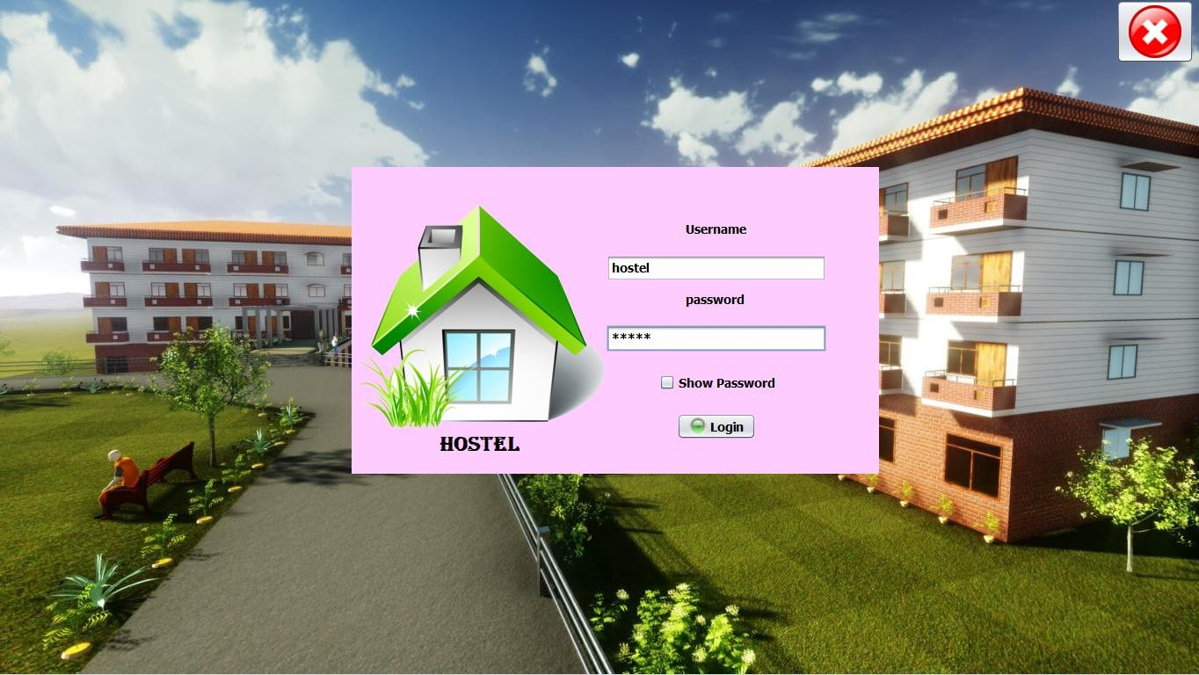
Login Page

Slide 12
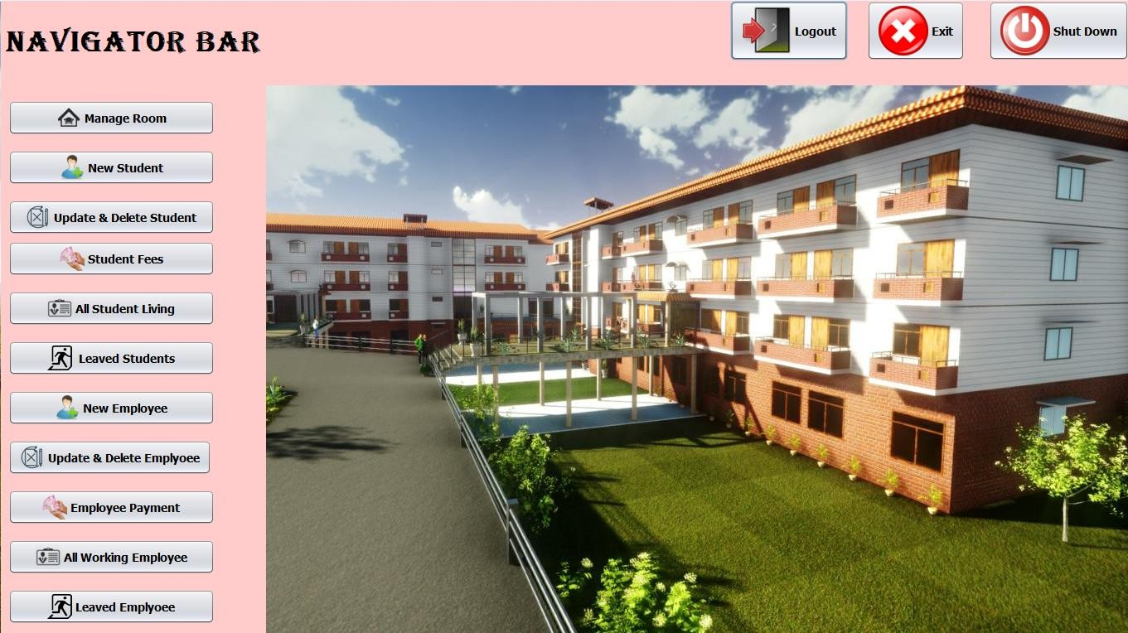
Home Page

Slide 13
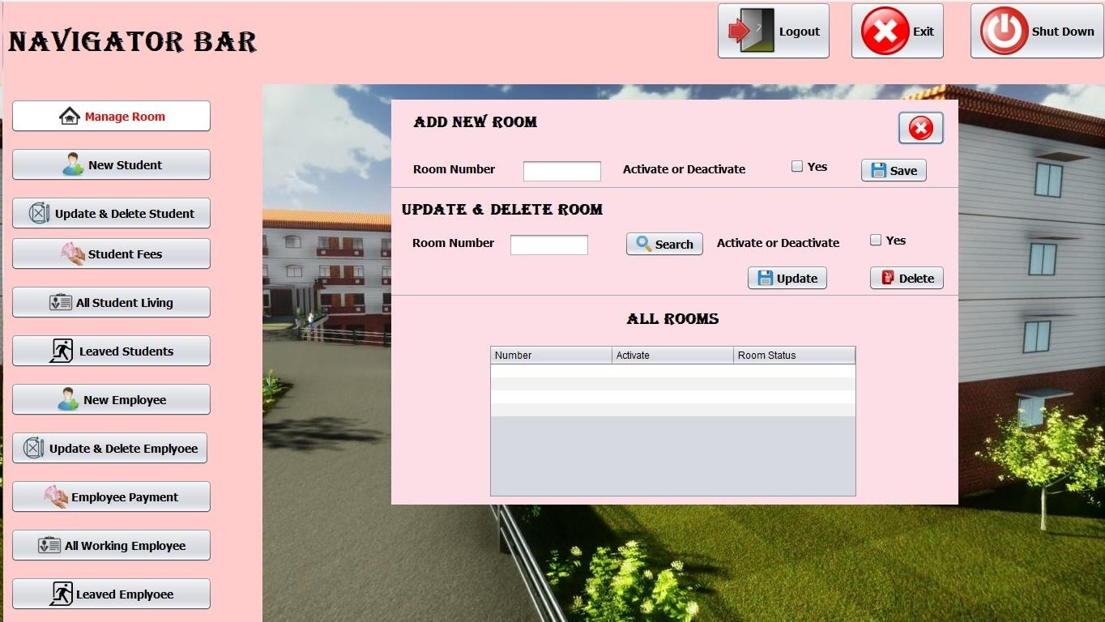
Managing Room

Slide 14
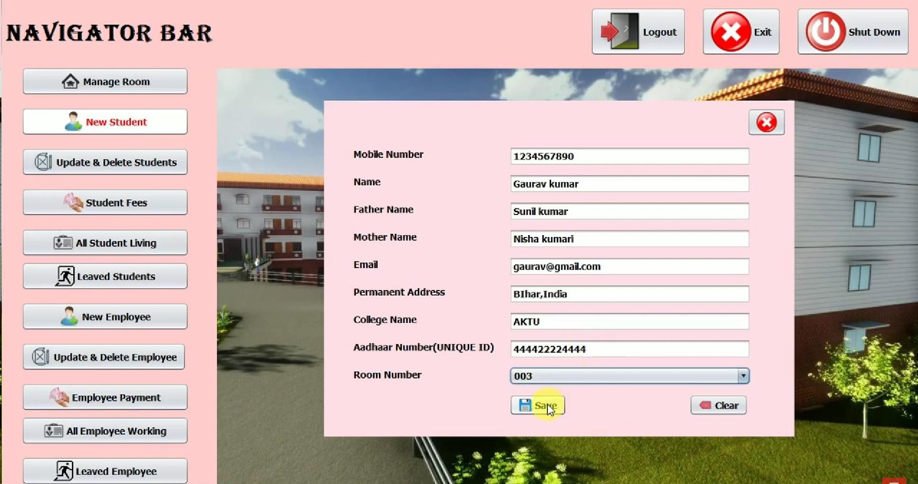
Add New Student

Slide 15
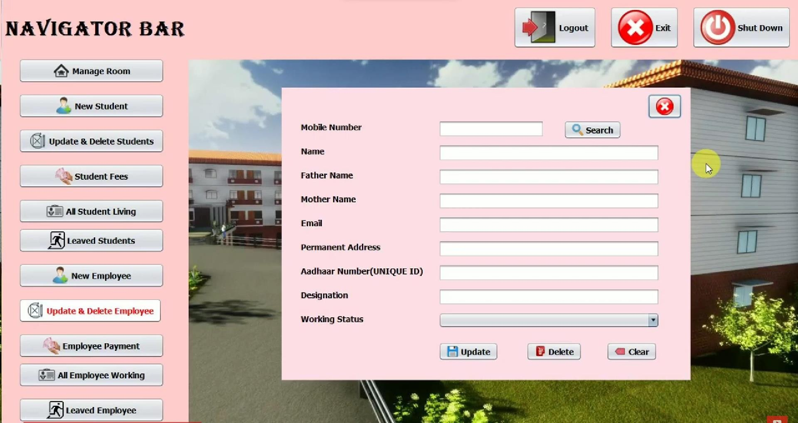
Update and Delete Employee

Slide 16

Mobile Applications
Online Payment and Financial Integration
Security Upgrades
Remote Management

Slide 17

Our project “HOSTEL MANAGEMENT SYSTEM” is a very helpful and important project that will manage various activities in the hostel like accommodation, rents, student records, Employee records ,their payments and and many other things that are very useful for a well- managed hostel.
It can also reduce the data losts , reduces time , help to maintain the records in proper manner.

Slide 18
Reference
Google :
https://www.mindluster.com/lesson/94724
YouTube: https://www.youtube.com/playlist?list=PLdRq0mbeEBmxkcuasB3D1 grHjNFwwrMeo
Website: www.academia.edu/37040228/HOSTEL_MANAGEMENT_SYSTE M_full_project
Example of journal Paper: https://ieeexplore.ieee.org/search/searchresult.jsp?newsearch=true&qu eryText=hostel%20managament%20syetem

Slide 19





